Slide 1
Green University of Bangladesh
Department of Computer Science & Engineering
Subject: Algorithms theory
Course Code:CSE-205
My Presentation topic : Breadth First Search (BFS)
Submitted To:
Name :Jargis Ahmed
Designation : Lecturer
Department : CSE
Green University of Bangladesh
Submitted by :
Name : Jakirul Islam
ID : 193002101
Section :DC(193)
Department : CSE

Slide 2
Outline
What is BFS?
Graph Variations
Application of BFS?
Conclusion

Slide 3
What is Breadth First Search (BFS)
Breadth-first search (BFS) is an algorithm for traversing or searching Tree or Graph data structures.

Slide 4
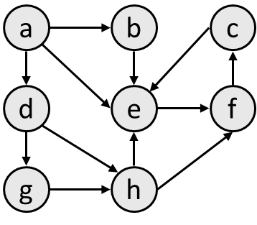
Breadth First Search (BFS)
breadth-first search (BFS): Finds a path between two nodes by taking one step down all paths and then immediately backtracking.
Often implemented by maintaining a queue of vertices to visit.
BFS always returns the shortest path (the one with the fewest edges) between the start and the end vertices.
to b: {a, b}
to c: {a, e, f, c}
to d: {a, d}
to e: {a, e}
to f: {a, e, f}
to g: {a, d, g}
to h: {a, d, h}

Slide 5
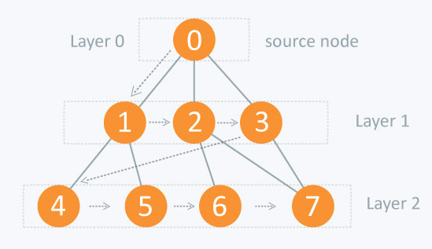
Breadth First Search (BFS)

Slide 6
Breadth First Search (BFS)
The process of BFS:
Visiting a Vertex: It means going on a particular vertex or checking a vertex’s value.
Exploration of Vertex: It means visiting all the adjacent vertices of a selected node.
Traversing: Traversing means passing through nodes in a specific order 7 We Should Know
Level-Order: It is a traversing method, where we have to visit every node on a level before going to a lower level.

Slide 7
There are many applications Breadth First Search
Broadcasting in Network: In networks, a broadcasted packet follows Breadth First Search to reach all nodes.
In Garbage Collection: Breadth First Search is used in copying garbage collection.
Peer to Peer Networks: In Peer to Peer Networks like BitTorrent, Breadth First Search is used to find all neighbor nodes.
Social Networking Websites: In social networks, we can find people within a given distance ‘k’ from a person using Breadth First Search till ‘k’ levels.

Slide 8
Conclusion Breadth First Search (BFS)
Breadth First Search (BFS) algorithm is a very important algorithm that traverses a graph in a breadth ward motion and uses a queue (FIFO, First-In-First-Out method) to remember to get the next vertex to start a search, when a dead end occurs in any iteration. Breadth-first search can be used to solve many problems in graph theory. It can also be applied to solve of many real life problems for example GPS Navigation systems, Computer Networks, Facebook structure, Web Crawlers for search engine etc.

Slide 9
Thank you

